Slide 1
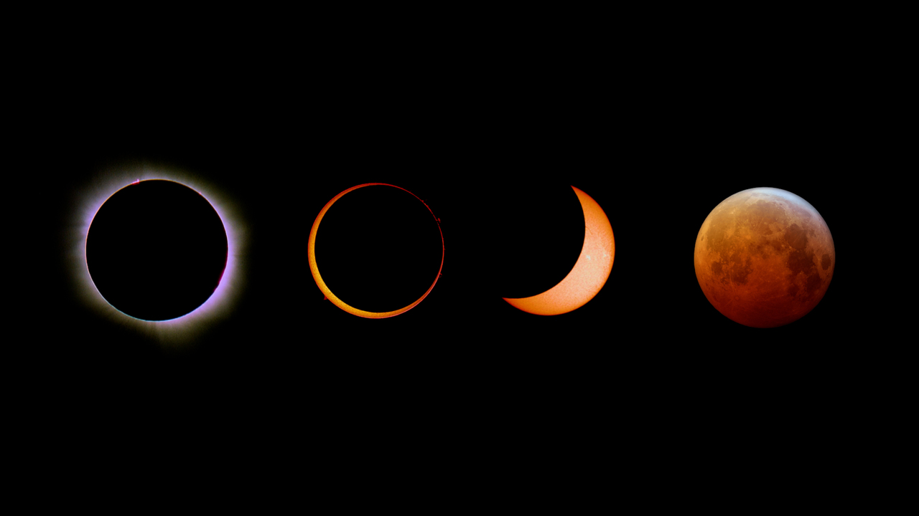
Project Tittle – Eclipses : Perspective is Everything
Team Name : Little Thinkers
R.Priyadharshini
D.Vishwapriya
K.S.Saranya
A.Haripriya
Y.Dhanalakshmi
G.Mariselvi

Slide 2
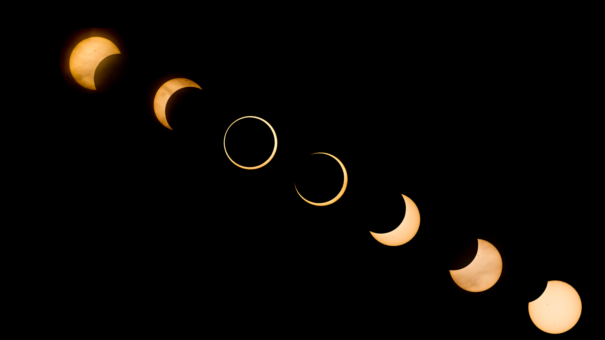
Description about our project :
Working Model :
In your challenge we built a working model for eclipse both the solar and the lunar ecplise . In this model elaborates detail about the eclipse
Code Developing :
We develop a code using python libraries to demonstrate the lunar and solar ecplise . In the results of this code we can visual see the eclipse .

Slide 3
How do eclipses occur ?
A solar eclipse happens when the Moon passes between the Sun and Earth, casting a shadow on Earth that either fully or partially blocks the Sun's light in some areas. This only happens occasionally, because the Moon doesn't orbit in the exact same plane as the Sun and Earth do.
Why do only some people on Earth see an eclipse at a given time ?
A solar eclipse occurs when the Moon comes between Earth and the Sun. In this process, the moon casts a shadow over Earth. The moon moves over the sun during the day and it becomes dark as the sunlight gets blocked.
Since Moon is smaller as compared to the Sun and Earth, its shadow on Earth isn’t very big. As a result, only some places on the planet get to witness the phenomenon. People who are on the sunny side of Earth and in the path of the moon’s shadow can see the solar eclipse, while others miss it.
A lunar eclipse will be visible to anyone who can see the moon in the sky. At any given instant, the moon is above the horizon for about half the Earth. Since a lunar eclipse can only occur during a full moon, then the half of the Earth that can see the moon at any instant is roughly the half that is experiencing nighttime.
So, if a lunar eclipse occurred only took an instant to occur, then about half the Earth — the part for whom it is night — could see it.

Slide 4
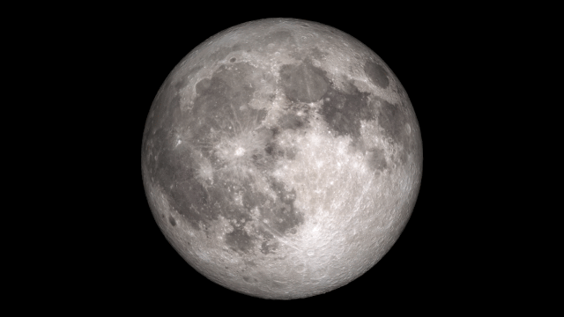
A
How to lunar eclipse occur ?
The Moon moves in an orbit around Earth. At the same time, Earth orbits the Sun. Sometimes Earth moves between the Sun and the Moon. When this happens, Earth blocks the sunlight that normally is reflected by the Moon. There are two types of lunar eclipses:
Total lunar eclipse.
Partial lunar eclipse.
A total lunar eclipse occurs when the Moon and the Sun are on exact opposite sides of Earth. Although the Moon is in Earth’s shadow, some sunlight reaches the Moon. The sunlight passes through Earth’s atmosphere, which filters out most of the blue light. This makes the Moon appear red to people on Earth.
A partial lunar eclipse happens when part of the Moon enters Earth’s shadow. In a partial eclipse, Earth’s shadow appears very dark on the side of the Moon facing Earth. What people see from Earth during a partial lunar eclipse depends on how the Sun, Earth and Moon align.
A lunar eclipse usually lasts for a few hours. At least two partial lunar eclipses happen every year, but total lunar eclipses are rare. It is safe to look at a lunar eclipse.

Slide 5
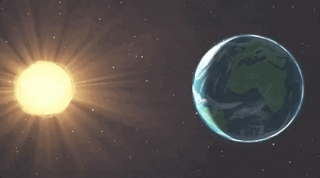
What is a Solar Eclipse?
Sometimes when the Moon orbits Earth, the Moon moves between the Sun and Earth. When this happens, the Moon blocks the light of the Sun from reaching Earth. This causes an eclipse of the Sun, or a solar eclipse. During a solar eclipse, the Moon casts a shadow onto Earth.
There are three main types of solar eclipses:
Total solar eclipse: A total solar eclipse is visible from a small area on Earth. The people who see the total eclipse are in the center of the Moon’s shadow when it hits Earth. The sky becomes very dark, as if it were night. For a total eclipse to occur, the Sun, Moon and Earth must be in a direct line.
Partial solar eclipse: This happens when the Sun, Moon and Earth are not exactly aligned. The Sun appears to have a dark shadow on a small part of its surface.
Annular (an-yə-lər) solar eclipse: An annular eclipse happens when the Moon is farthest from Earth. Because the Moon is farther away, it seems smaller. It does not block the entire view of the Sun. The Moon in front of the Sun looks like a dark disk on top of a larger Sun-colored disk. This creates what looks like a ring around the Moon.

Slide 6
What causes the Sun,Moon and Earth to align ?
When the Earth, Moon, and Sun are aligned, it’s called an eclipse. If the Moon is between the Earth and the Sun, it’s a solar eclipse .
If the Moon is behind the Earth, it’s a lunar eclipse. If the Sun is between the Earth and the Moon, we would both then be inside of the Sun, in what is called an “apocalypse”
How often do eclipses occur ? A lunar eclipse and a solar eclipse both occur roughly twice a year, and a solar eclipse is always about two weeks before or two weeks after a lunar eclipse. (4 weeks = 1 month = roughly 1 orbit of the moon around the earth)
In most calendar years there are two lunar eclipses; in some years one or three or none occur. Solar eclipses occur two to five times a year, five being exceptional; there last were five in 1935, and there will not be five again until 2206.
How do scientists know when and where eclipses will occur ?
Eclipses occur in patterns. The Saros Series is a period of 223 lunar months that has been used to predict eclipses for thousands of years. In a Saros Series, exactly 9 years, 5.5 days after any lunar eclipse, a solar eclipse will occur, and vice versa.
What is the difference between a lunar and solar eclipse ?
Solar eclipses occur when the Moon passes between Earth and the Sun, leaving a moving region of shadow on Earth’ssurface. Lunar eclipses occur when Earth passes between the Sun and the Moon, casting a shadow on the Moon. What is an eclipse season and why do they occur approximately every six month (or twice a year) ?
An eclipse season is one of only two periods during each year when the Sun, Moon, and Earth are aligned, allowing eclipses to occur. Each season lasts about 35 days and repeats just short of every six months. In addition to inspiring artists and musicians, eclipses have driven numerous scientific discoveries.

Slide 7

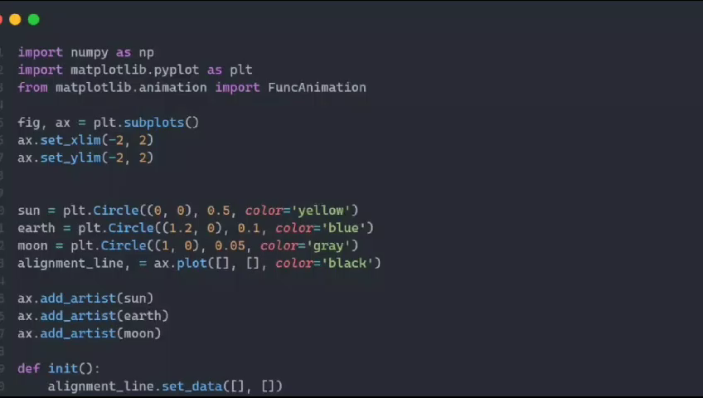
Our Work Space :
Working Model :
Code :

